Slide 1
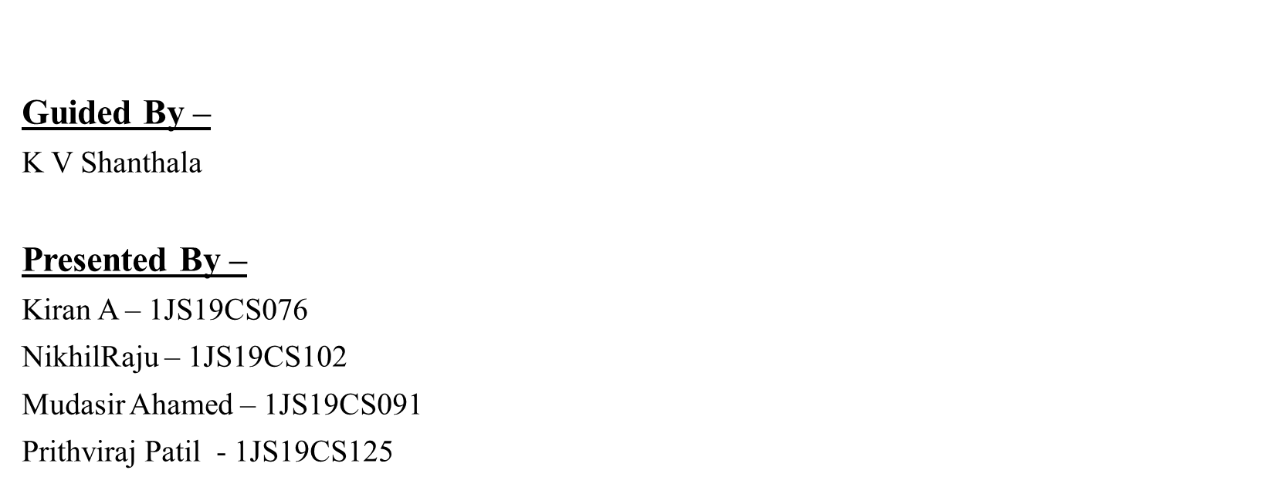
Virtual Telepresence Robot

Slide 2
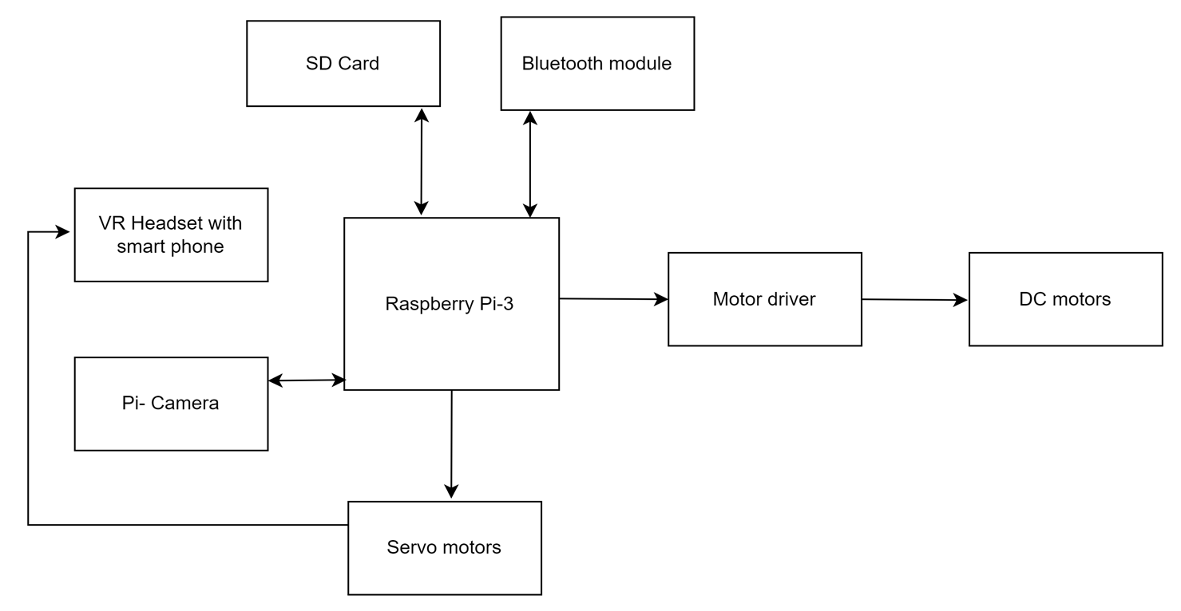
Architecture Diagram

Slide 3
Raspberry Pi 3
The Raspberry Pi is a low cost, credit-card sized computer. It is a capable little device that enables people of all ages to explore computing, and to learn how to program in languages like Scratch and Python. It’s capable of doing everything you’d expect a desktop computer to do, from browsing the internet and playing high-definition video, to making spreadsheets, word-processing, and playing games.
Processor: Broadcom BCM2837B0, 1.4 GHz
Memory: 512MB LPDDR2 SDRAM
Access: Extended 40-pin GPIO header
SD card support: Micro SD format for loading operating system and data storage.

Slide 4
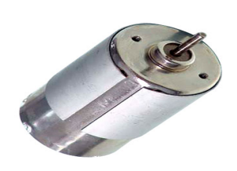
DC Motor
A dc motor uses electrical energy to produce mechanical energy, very typically through the interaction of magnetic fields and current-carrying conductors. The reverse process, producing electrical energy from mechanical energy, is accomplished by an alternator, generator or dynamo. Many types of electric motors can be run as generators, and vice versa. The input of a DC motor is current/voltage and its output is torque (speed).

Slide 5
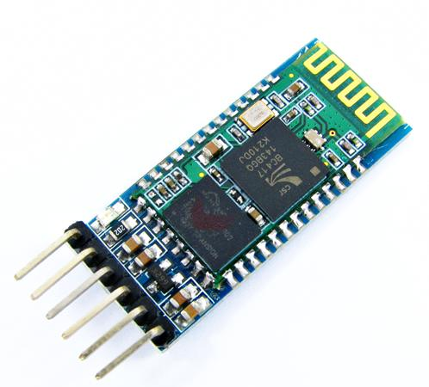
Bluetooth Module HC – 05
HC‐05 module is an easy-to-use Bluetooth SPP (Serial Port Protocol - In computing, a serial port is a serial communication interface through which information transfers in or out sequentially one bit at a time).
This is in contrast to a parallel port, which communicates multiple bits simultaneously in parallel.

Slide 6
Algorithm for Robot movement.
Step 1 - Open Bluetooth Terminal app
Step 2 - From the menu, tap on "Connect a device - Insecure“
You will see a pop-up of "Paired Devices
Step 3 - tap on "HC-05", after a second you will get a toast notifying "Connected to HC-05“
Step 4 - Now press button “forward" and robot will move forward, similarly, press button "backward“, “left”, “right”, to perform other respective operations.

Slide 7
Thank you

